Slide 1



The GEF - IFAD Project
Project countries : Ethiopia, Rwanda, Mozambique
“SMARTFARM”
Winner at
GEF Challenge Program for Adaptation Innovation
UNFCCC COP26 Glasgow

Slide 2
STRATEGIES TO ADDRESS THE STATED CLIMATE ADAPTATION
The GEF - IFAD Project
Project countries : Ethiopia, Rwanda, Mozambique
COMPONENT 1
COMPONENT 2
COMPONENT 3
Deployment and scaling up of SMARTFARM
To support 200,000 Smallholder farmers (SHFs) for two years to deliver climate smart & precision agriculture (CSA) being data driven built on digital technologies. This component also identifies farmer institutions which will act as grassroots institutions responsible for digital technology adoption and collective bargaining power for farmers.
Capacity building
2000 village based extension workers / field officers / agri-entrepreneurs on digital technologies to support the climate smart & precision agriculture implementation for grassroots/farmers institutions.
Knowledge management & sharing learnings
From climate adaptation digital models, and building partnerships with research institutions , govts , development partners for scalability, replicability, and sustainability. The objective is to develop the advance phase of the project on access to markets and access to finance for smallholder farmers.
CROPIN Global Agricultural Development Centre, The Hague, Netherlands

Slide 3
FOUR STEP PROCESS
Site-specific & Region-specific Digital Agriculture Solutioning Approach
01
Data collection/Acquiring data
Three-pronged data approach (3PDA) of present and historical data at the site:
In-situ data from the SMARTFARM.
Remote sensing data from Satellite/UAVs/Ground sensors.
Climate & weather data and projections.
Data analysis & information maps
Detection, identification and characterization of site-specific:
Agronomy issues on crop planning, crop physiology, health and nutrient, crop stress, water stress, harvest, weeds, pest & disease, climate shocks
Market issues
Credit issues (loans & insurance) and underlying reasons at the farm site from the acquired data into information maps.
02
4-STEPS APPROACH
04
Design of Region-specific solution
The site-specific solution is extrapolated into region specific solution based on regional level data.
Applying analysis and Design of site-specific solution
The analysis and information is converted into site-specific strategies & solutions to tackle agronomy, climate, credit (loans & insurance), and market issues. This includes:
Design of site-specific solutions based on digital technology, products and methods.
Alerts, advisories, counter moves for farmers and policy makers.
Implementation, feedback, iteration and re-design.
03
CROPIN Global Agricultural Development Centre, The Hague, Netherlands

Slide 4
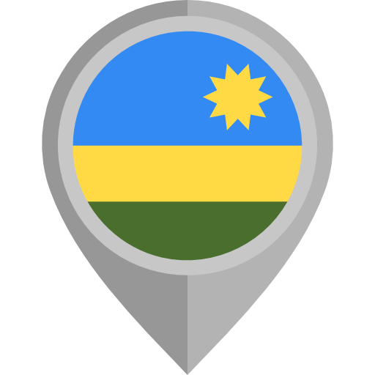


CROPIN PAST & EXISTING WORK IN PROJECT COUNTRIES
&
Alignment with GEF - IFAD country programmes
Rwanda
Ethiopia
Mozambique
Digitization of Coffee Supply Chain - Sucafina | 2Scale, Mercy Corps / Agricultural Transformation Agency (ATA) SUMINTER | Solidaridad Alliance for a Green Revolution in Africa (AGRA) Project INCAJU / Technoserve Plexus Cotton / Technoserve
Partnership for Resilient and Inclusive Small Livestock Markets Programme Kayonza Irrigation and Integrated Watershed Management Project - Phase I Rwanda Dairy Development Project | Rural Financial Intermediation Programme III Lowlands Livelihood Resilience Project Participatory Small-scale Irrigation Development Programme II | Inclusive Agrifood Value Chain Development Programme Small-scale Aquaculture Development Project Rural Enterprise Finance Project
CROPIN Global Agricultural Development Centre, The Hague, Netherlands

Slide 5


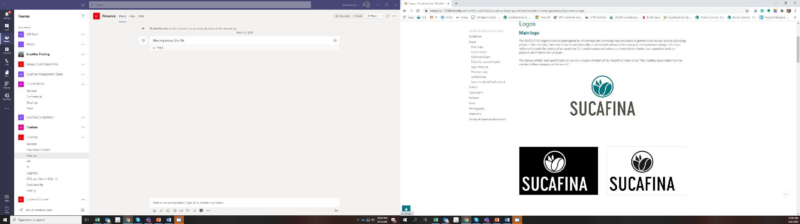






DIGITIZATION OF COFFEE SUPPLY CHAIN - SUCAFINA
From Bean To Cup: Ensuring An Effective Coffee Value Chain
More than 50 Field Supervisors were trained and are currently Using the system:
The Challenge
Sucafina is a leading sustainable Farm to Roaster coffee company, with a family tradition in commodities that stretches back to 1905. is one of the leading coffee trading houses in the world, and one of the few focused entirely on coffee. Their extensive supply chains span from producer-facing export operations to destination sales offices around the world.
Impact
20,898 famers registered, followed-up and verified for certifications;
175 trainings have so far been scheduled;
725 farm plots have been visited and geo-tagged in the system;
365 input loans have since been requested and tracked by the system;
More than 1,000 individual coffee purchase transactions have so far been recorded into the system
CropIn partnered with Sucafina in Jan 2021 to support its Coffee sustainability plan, by recording and tracking all sustainability activities with farmers for projects in Uganda, Rwanda, and Burundi. CropIn’s unique suite of solutions - SmartFarm® and mWarehouse.
Digital Engagement
Farmer
Sucafina
Roaster
Consumer
Sustainable Government
.
Nearly 1,500 individual farmers have been trained so far, on financial literacy, Village Savings and Loan Associations and Good Agricultural Practices. The trainings are verifiable based on key information captured:
GPS coordinates of where the training took place;
Photographs of participants;
Digitally signed attendance list
This project contributes to the below UNSDGS:
CROPIN Global Agricultural Development Centre, The Hague, Netherlands

Slide 6

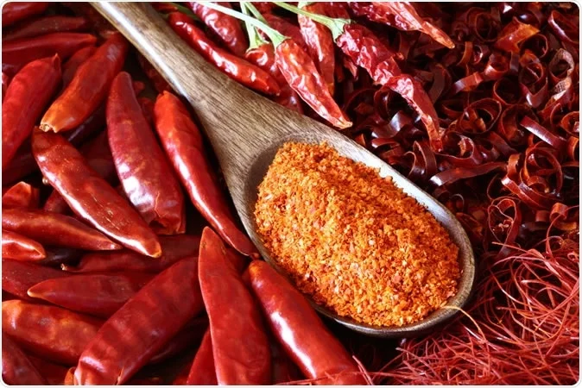
STRENGTHENING ORGANIC PRODUCTION - SUMINTER
Impact
Over 60k farmers digitized
65k plots recorded
14k+ acres geotagged
20+ crops monitored
Complete Technology Adoption with over 70+ local resources
End-to-end traceability from Nursery to Trade
100% transparency through near real-time monitoring
Suminter India Organics is a privately held supplier of certified organic products from India to Europe and the United States. Suminter is working across nine Indian states for 1,10,000 acres of certified agriculture land to grow, harvest and process organic goods.
Suminter adopted digitization in August 2018 to support its organic produce by recording and tracking all sustainability activities with farmers for projects in nine Indian states for-
Certifications & Farmer data digitization
Digitize Farming and track activities to optimise the field team’s expenses
Provide the end to end traceability to the customer through QR code,
Aid Suminter to revise pricing or give value addition to the produce.
CROPIN Global Agricultural Development Centre, The Hague, Netherlands

Slide 7

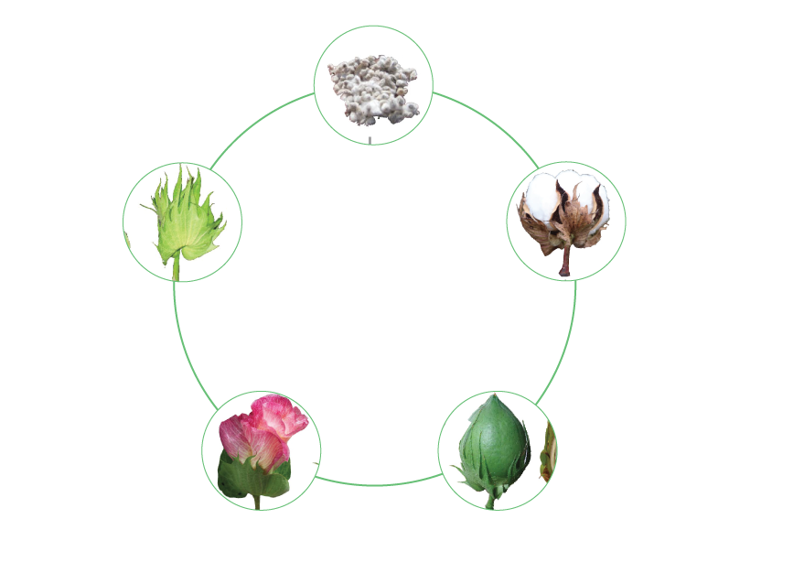
LEVERAGING TECHNOLOGY TO AID SMALLHOLDER COTTON FARMERS IN MOZAMBIQUE
The Challenge
Plexus Cotton is an agribusiness specializing in cotton farming and trading. They partner with various players along the agri supply chain to ensure sustainable practices while maximizing profit. This particular project in Mozambique involved working with smallholder farmers to ensure sustainable utilization of resources while maintaining complete traceability for CMIA (Cotton Made in Africa) certification.
Working with the international non-profit organization Technoserve, Plexus wanted to digitize over 40,000 farmers who were intermittently engaged with them. Their priorities were successful tracking of field work, as well as monitoring of seed and chemical distribution.
Impact
40,000+ farmers digitized from seed to sale
Over 180 field agents trained and active on SmartFarm
Digital Record keeping brought transparency, accountability and ease of doing business
Seed and chemical distribution data continuously being collected from end users for assessment
Crop advisory set up to help farmers during instances of weather risks, pest infestations and disease
Area Audit
Upload farmer
data and assign field agents
Capture and analyze harvest data
Enter and
record seed,
chemical and
bag distribution
Track output of field agents
CROPIN Global Agricultural Development Centre, The Hague, Netherlands

Slide 8
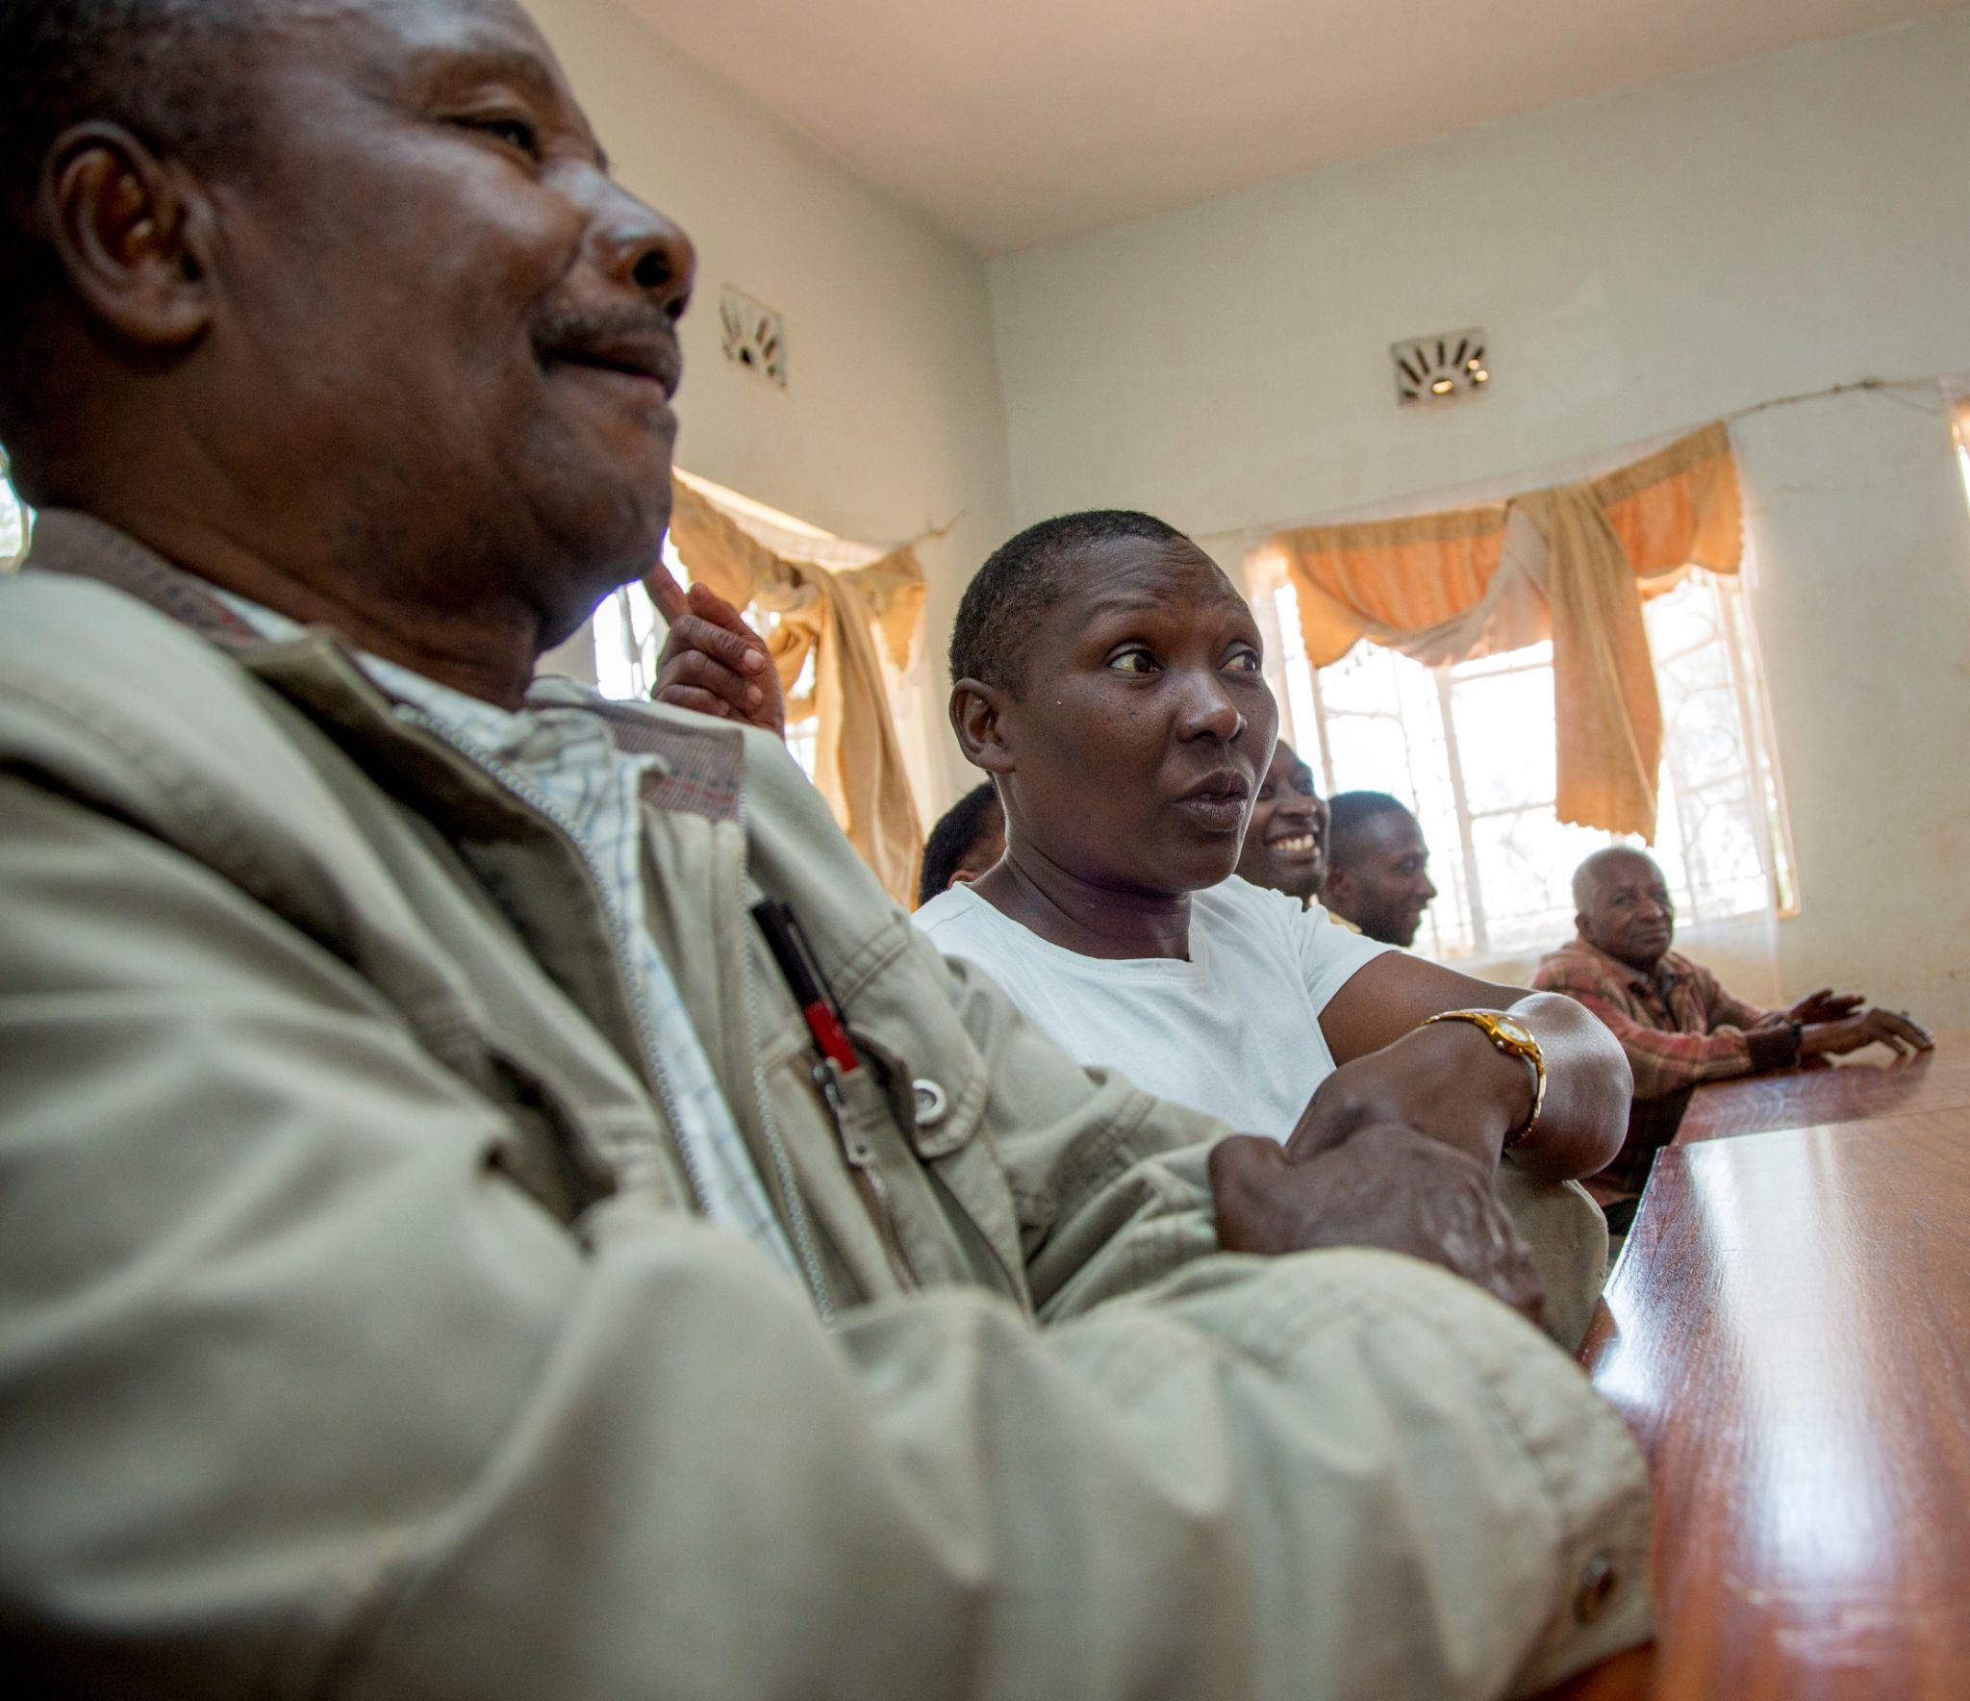
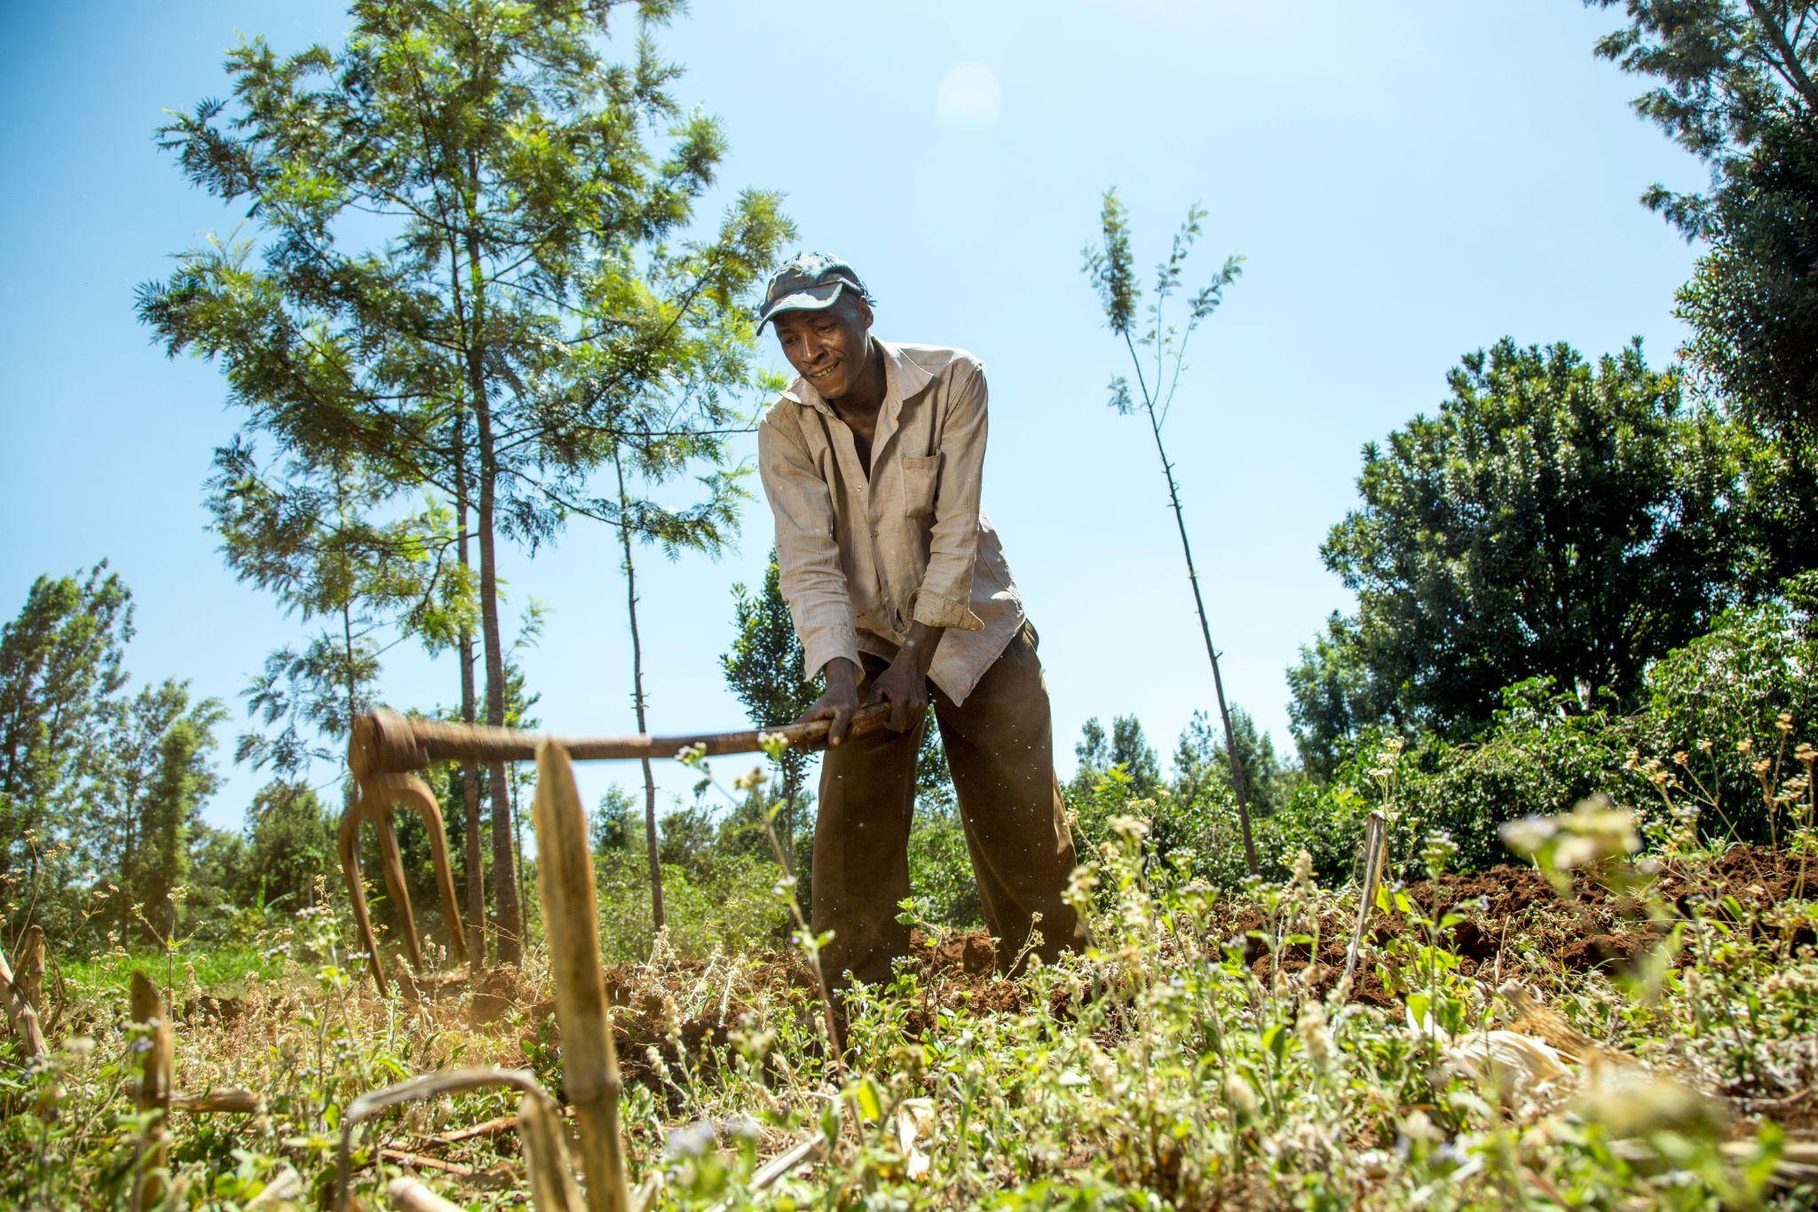
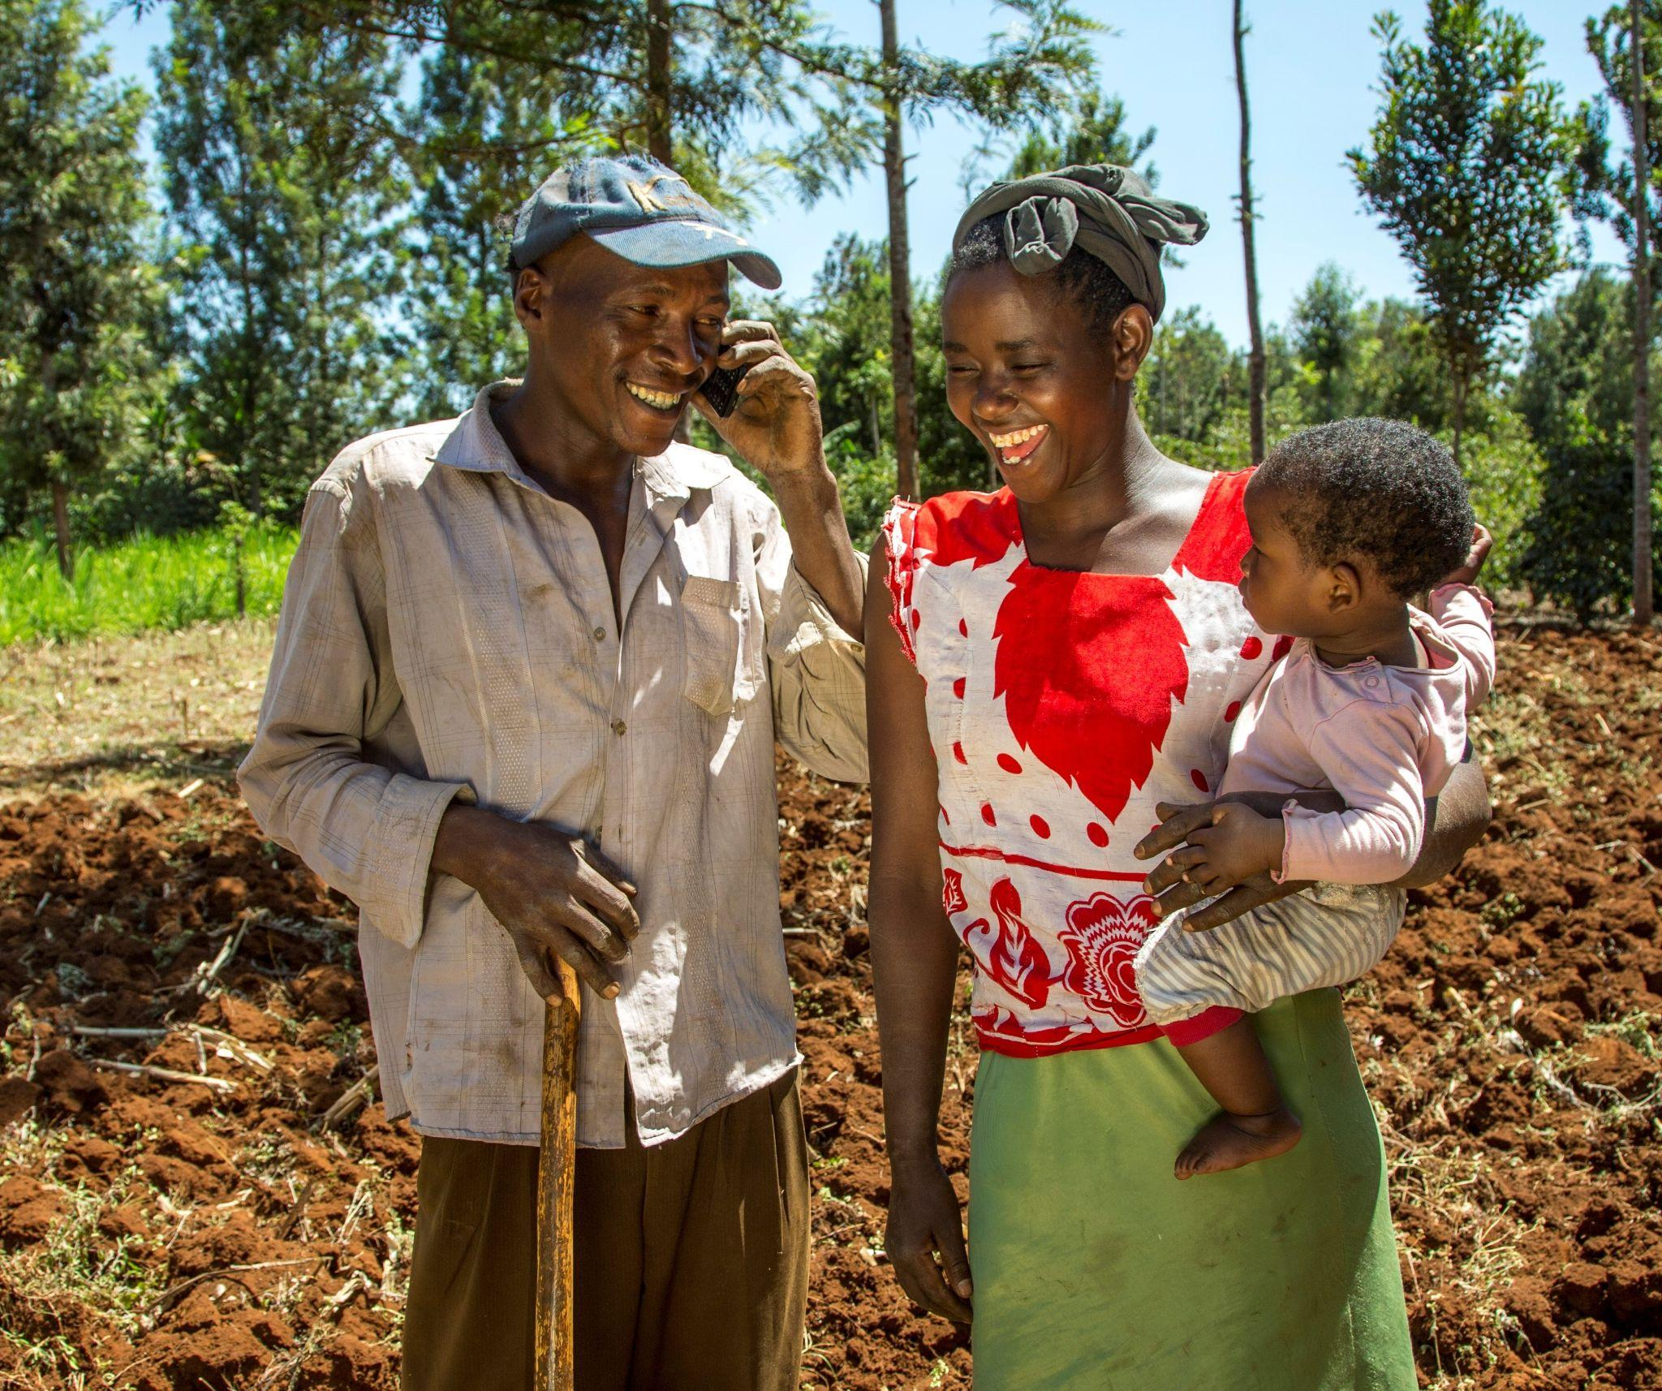
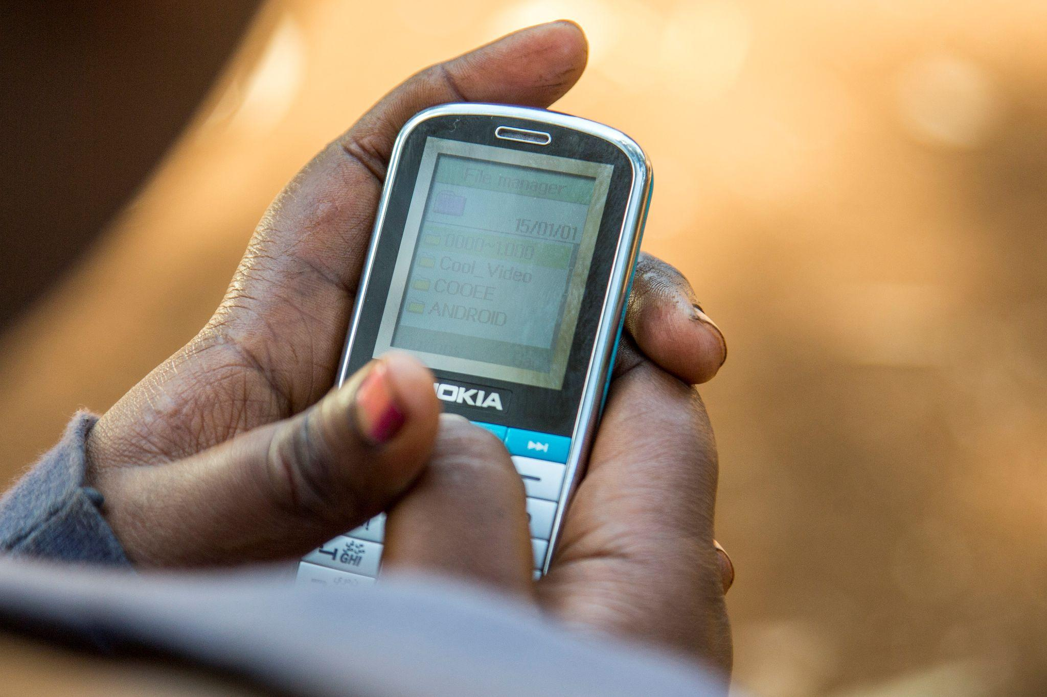
THANK YOU
https://www.youtube.com/watch?v=U8b1-gzB9gU
CROPIN Global Agricultural Development Centre, The Hague, Netherlands

